Slide 1
Protein-protein Docking between CXCL12 and CXCR4 Applied by Rosetta
Bin Ma
2019/12/10

Slide 2

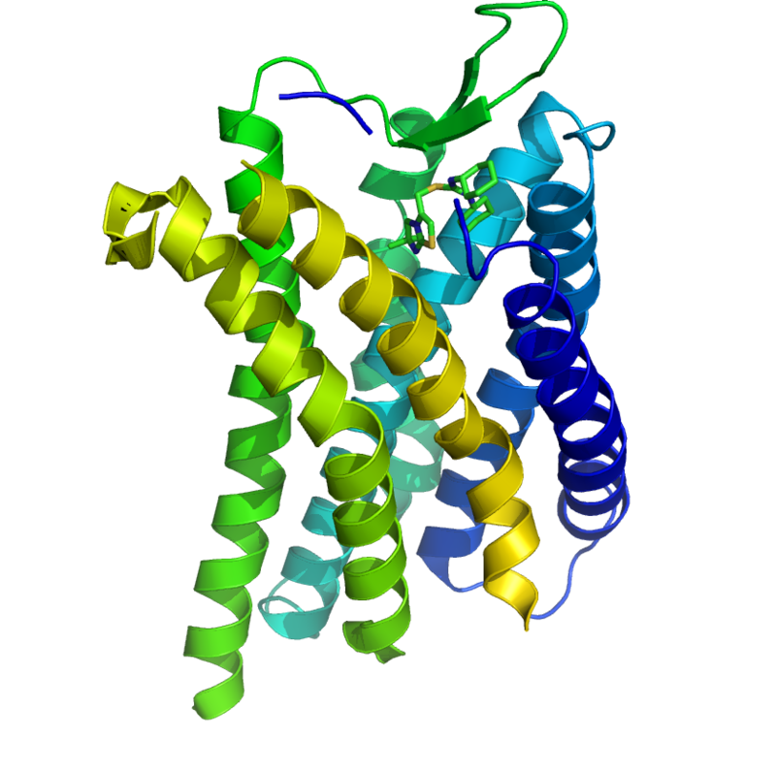
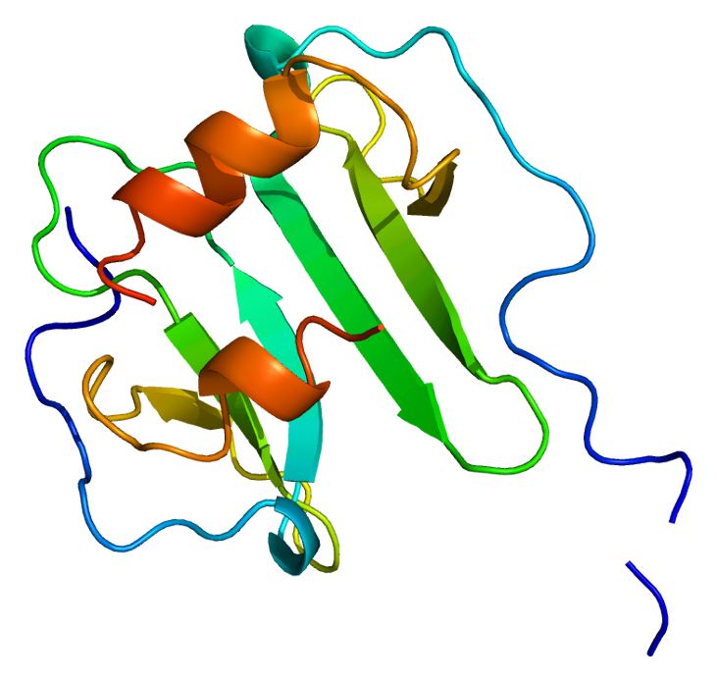
CXCR4 & CXCL12
HIV infection:
A consequence?
Or
A cause of immunodeficiency?
CXCR4
CXCL12
Notes:
Alpha-chemokine receptor specific for CXCL12, which is a molecule endowed with potent chemotactic activity for lymphocytes. The interaction between these two protein has drawn lots of attention in the past decade and has not get into a conclusion. CD4+ T cell

Slide 3
ROSETTA -Protein-protein Docking Package:
Docking prepack protocol: prepare structure.
Motif Dock Score.

Slide 4
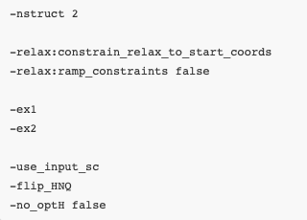
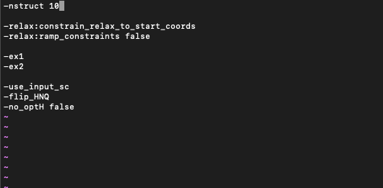
Relaxing the structure: flag file
CXCR4: 2k04
CXCL12: 3hp3

Slide 5
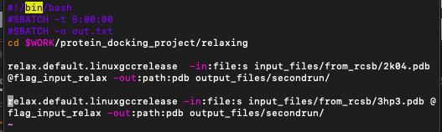
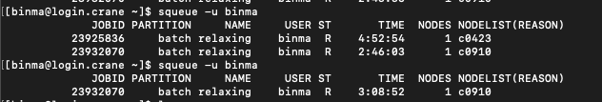
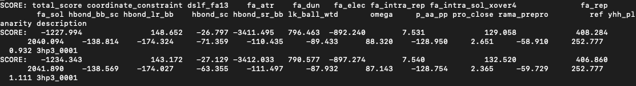

Relaxing the structure: submission script

Slide 6
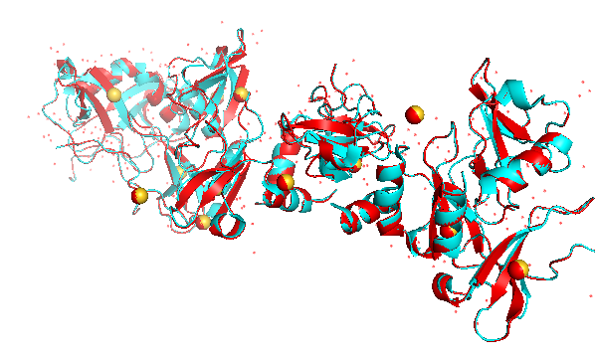
Relaxing the structure: 3hp3_0001.pdb & 3hp3.pdb

Slide 7
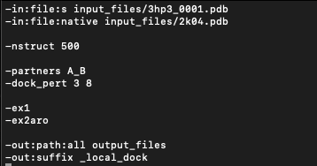
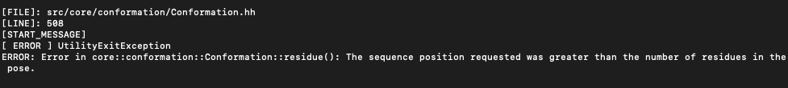
Protein-protein-docking

